Slide 1
GEMS: GPU-Enabled Memory-Aware
Model-Parallelism System for Distributed DNN
Training
钟赟
2021/7/27

Slide 2
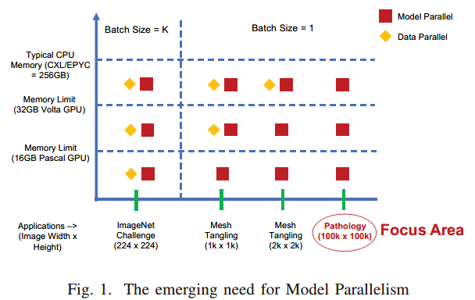
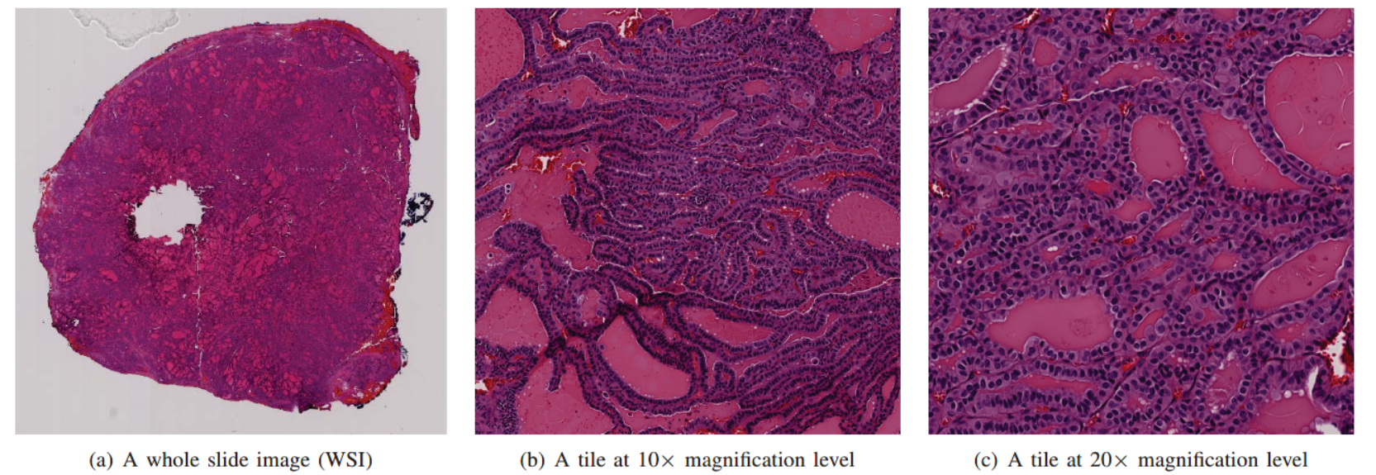
Background
DL-based Parallel strategies
Data Parallelism
offers near-linear scaling
limitation : too large models
Model Parallelism
assign the model to multiple GPUs
Hybrid parallelism

Slide 3
Contribution
GEMS: an integrated system that provides memory-efficient model parallel training and scalable hybrid parallel training
propose several design schemes:
Basic Model Parallelism (GEMS-Basic)
Memory Aware Synchronized Training (GEMS-MAST)
Memory Aware Synchronized Training with Enhanced Replications (GEMS-MASTER)
GEMS-Hybrid
1.36× speedup with MAST and 1.83× speedup with MASTER
near-linear scaling (97.32%) of hybrid parallel training on 1,024 Volta V100 GPUs
reduce the training time for ResNet-110-v2 from seven hours to 28 minutes

Slide 4
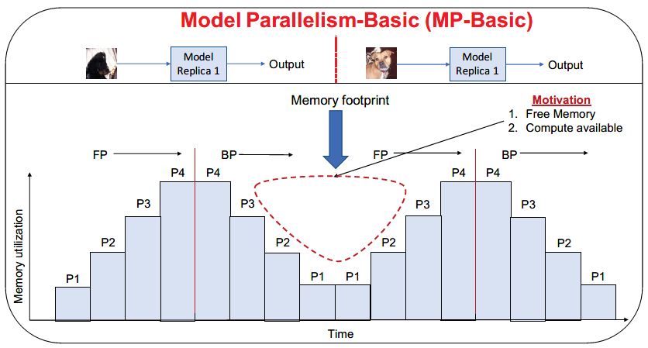
Motivation
Basic Model parallelism: Under-utilization of Memory
Data dependency
Forward pass
Li -> Li+1
Backward pass
Li -> Li-1

Slide 5
Challenges
GPU-based Communication in TensorFlow
overlap communication with computation: serializability problem
mpi4py: Numpy or Numba arrays
Memory management in TensorFlow
no memory management functionalities
Scaling Memory-Aware solutions
model parallelism: fit DNN to a small number of GPUs
apply data parallelism: supports parameters split across GPUs

Slide 6
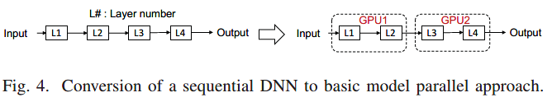
Limitations in Model Parallelism
Basic Model Parallelism
Under-utilization of resources
complex implementation compared to data parallelism

Slide 7
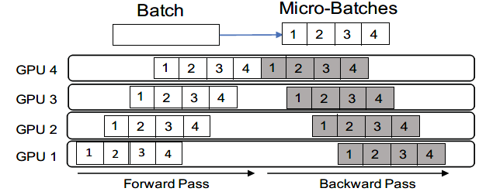
Limitations in Model Parallelism
Model Parallelism with Pipelining
parts=DNN splits, limited by Batch Size
poor performance

Slide 8
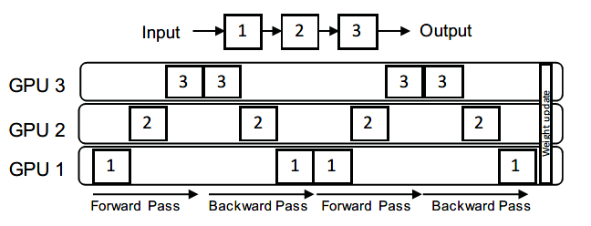
Limitations in Model Parallelism
Model Parallelism with Delayed Synchronization
Update parameters after N backward passes
DNN size and image size too large: e.g. Batch Size = 1
emulate BS = N

Slide 9
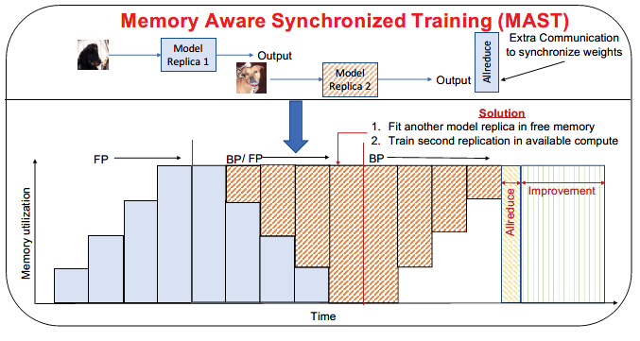
Method: GEMS-MAST
Memory View
training a replica of DNN in an inverted manner
Computational View
2 independent model partitions
2 overlapped allreduce operations

Slide 10
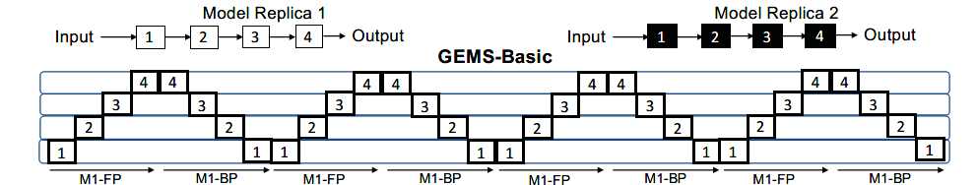
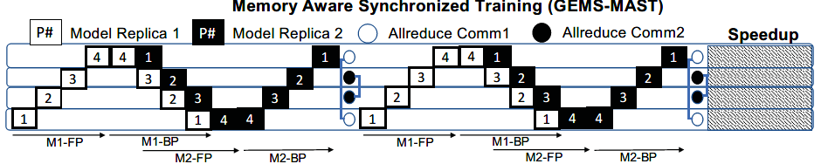
Method

Slide 11
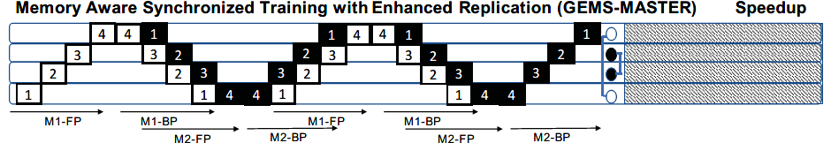
Method: GEMS-MASTER
2 model replicas
compute replications η=4
train a model with any batch size

Slide 12
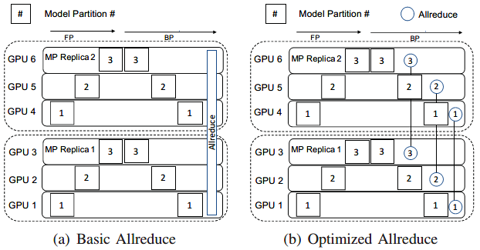
Method: GEMS-HY Basic
improve scalability
communicator: processes of same model partition

Slide 13
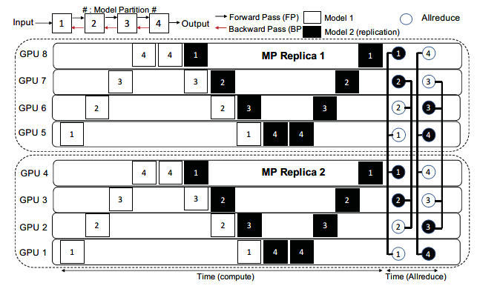
Method: GEMS-HY MAST

Slide 14
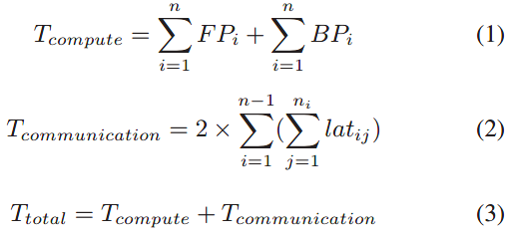
Analytical Model
Basic Model Parallelism
Tcompute : time spent in forward and backward pass in each partition
Tcommunication : time spent in communication
UnderutilizedComputei ：time when the ith GPU is idle
latij : the latency of sending a message from i to j

Slide 15
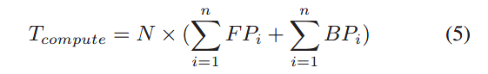
Analytical Model
Model Parallelism with Delayed Synchronization
batch size = N

Slide 16
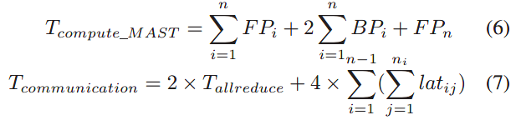
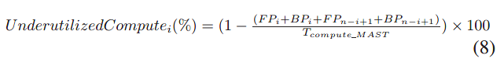
Analytical Model
GEMS-MAST

Slide 17
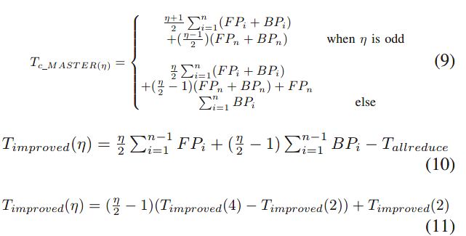
Analytical Model
GEMS-MASTER
the number of replications : η

Slide 18
Performance Evaluation
In-depth Performance Evaluation of various GEMS approaches
GEMS vs. existing frameworks that offer model/hybrid parallelism
Impact of GEMS on a real-world digital pathology problem
Evaluation Platform
OpenPOWER system: POWER9 processors, 4 NVIDIA Volta V100 GPUs
TensorFlow v1.14
ResNet

Slide 19
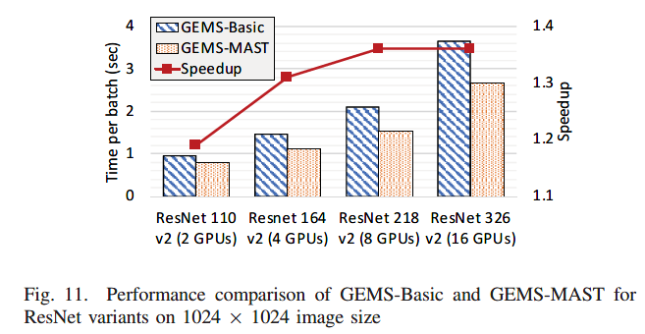
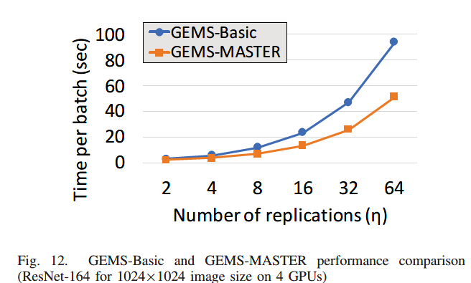
Performance Evaluation

Slide 20
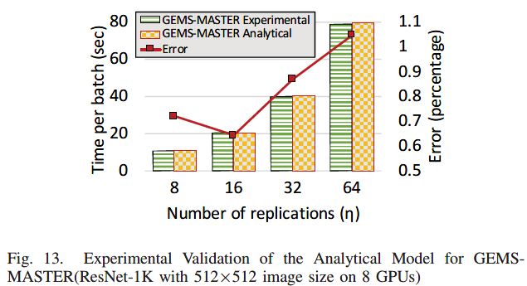
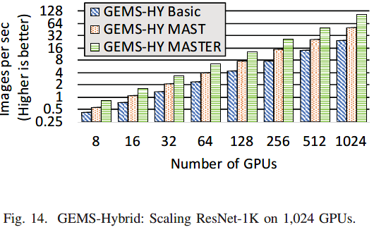
Performance Evaluation

Slide 21
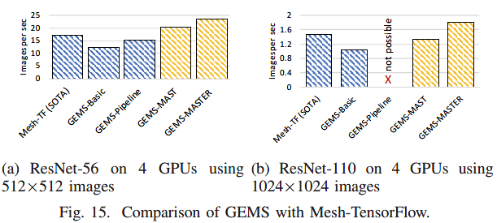
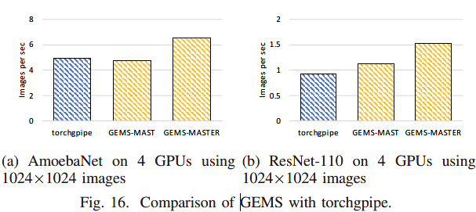
Performance Evaluation

Slide 22
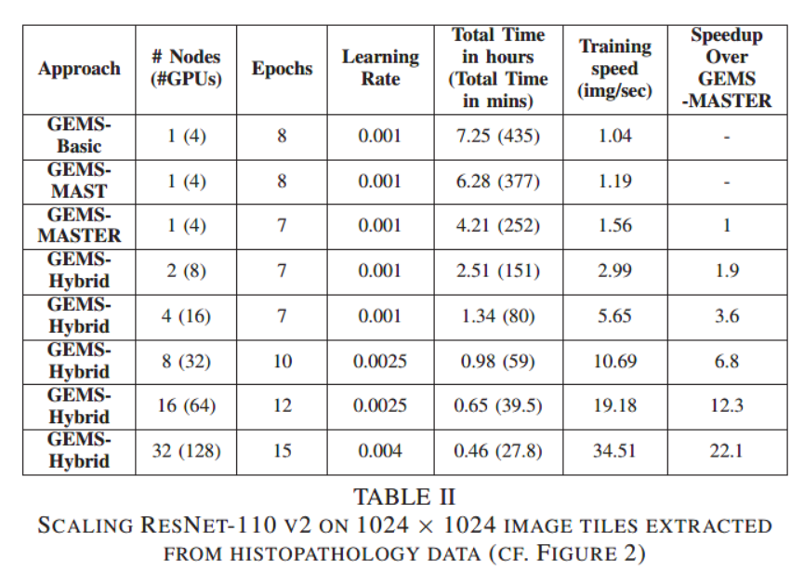
Performance Evaluation

